Slide 1
TEAM MEMBERS
BREAST CANCER PREDICTION MODEL
María José García
Daniel Murillo
Paul Garay
Roberto Barrón
Machine Learning
https://github.com/MajoGarciaMontes/FINAL-PROJECT

Slide 2
CONTENT
01
Objective / main questions
02
Architecture of our ML solution
03
Data gathering and cleansing
04
ML model design
05
API integration
06
Visualization / Dashboard
07
Conclusions / Next steps

Slide 3

OBJECTIVE / MAIN QUESTIONS
CONTEXT
OBJECTIVE
Develop a Machine learning model aimed to learn through several breast cancer variables in order to predict the probability of developing breast cancer.
‘A woman born today has about a 1 in 8 chance of being diagnosed with breast cancer at some time during her life’ National Cancer Institute
Costs of having more advanced tests done in order to determine whether a tumor is benign or malignant can go up exponentially, which means that not every patient will be able to have them done.
MAIN QUESTIONS TO SOLVE

What classification fits the patient? (benign / malignant tumor).
Which is the best model to use?
What is the accuracy of the classification?

Slide 4
ARCHITECTURE OF OUR ML SOLUTION
During the last 6 months we have learned to create data solutions...
PROJECT PROPOSAL
ETL
ML DESIGN
API
DASHBOARD CODING
USER TESTING
PROJECT EVALUATION

Slide 5

DATA GATHERING / CLEANSING
GATHERING
We were looking for a dataset with relevant information and with a significant size to train the data with ML.
WHERE?
FORMAT
SIZE
CONTENT
University of Wisconsin (DS) repository
30 variables of characteristics of the tumor and the final diagnosis
CSV file
569 datapoints
Cleansing for database creation
Drop of columns without data
Check for missing values
Cleansing for ML model
Pre-process of categorical data
Drop of unnecessary columns
CLEANSING

Slide 6

ML MODEL DESING
LOGISTIC REGRESSION
Precision
Recall
F1-score
The model is accurate for both benignant and malignant tumors, the classifications are very likely correct with high precision scores and the model correctly finds nearly all the true “malignant tumors” as the recall scores were extremely high.
BENIGN
0.97
0.97
0.97
PROCESSING
MALIGNANT
0.96
0.94
0.95
Accuracy
0.97
PREDICT
SCALING
RANDOM FOREST
Precision
Recall
F1-score
BENIGN
0.99
0.98
0.98
MALIGNANT
0.96
0.98
0.97
Accuracy
0.98
WHY IT IS IMPORTANT TO LOOK FOR THE HIGHEST PREDICTION RECALL?
The costs of mis-classifying a 'malignant tumor' as a 'benign tumor' are extremely high. It was not acceptable that this kind of tool could misdiagnose a patient with cancer as a 'healthy patient' and send them home without treatment.

Slide 7
API INTEGRATION
WHAT?
Flask API that allows users to submit input data for breast cancer prediction and returns evaluations of prediction model.
connection to a database using SQLAlchemy
Extracting input values from the request and used to make predictions with ML model.
prediction route
The predicted result is rendered on a template.
Definition of Flask routes to handle different API endpoints
model-scores route
Returns the evaluation scores of the breast cancer prediction model.
index route
Returns an HTML file for visualization purposes.

Slide 8
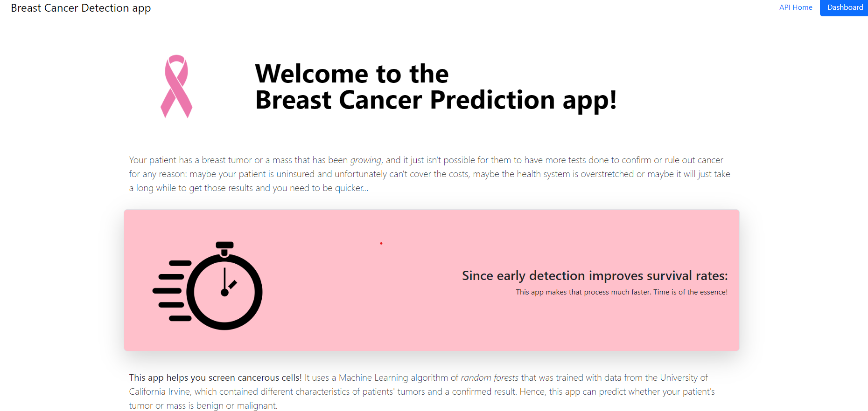
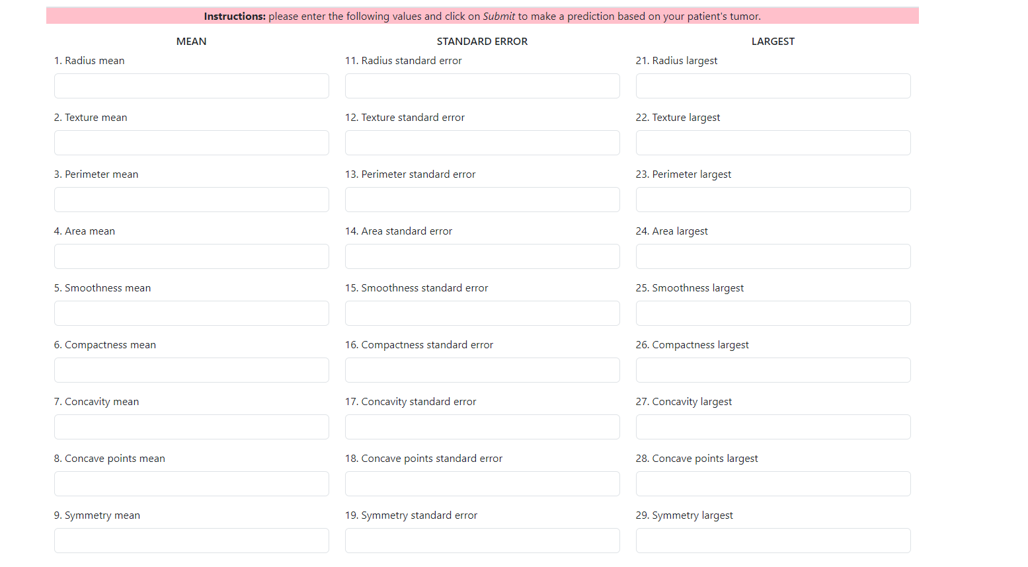
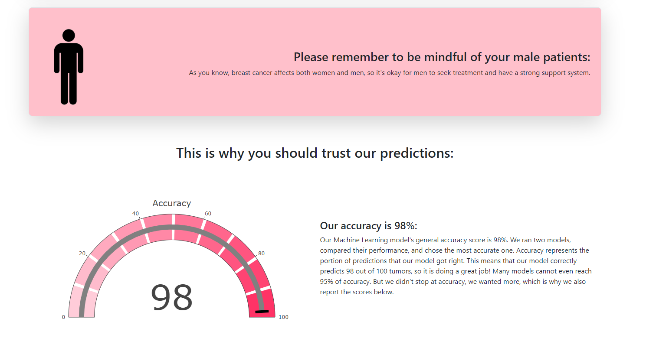
VISUALIZATION / DASHBOARD
Friendly and simple, empowered by a potent ML model.
Allow users (doctors) to take decisions before prescribing patients more expensive tests
30 inputs to fill and compare the patient’s tumor vs prediction model
Scores showing the confidence of the model
Results for the patient and recommendation

Slide 9
CONCLUSIONS / NEXT STEPS
Our model was successful on learned with the provided dataset and develop a high level of prediction of breast cancer.
A random forest model achieves high accuracy, precision, f1-scores and recall vs logistic regression.
ML has the potential to reduce costs while still being reliable for screening breast cancer.
NEXT STEPS
Having more recent data could improve our precision and make our model be more in touch with today.
Having more observations could improve the model scores or even work better with other ML models or to improve the effectiveness trough a Neural Network.

Slide 10
ANY QUESTION?































○

↑






